Slide 1
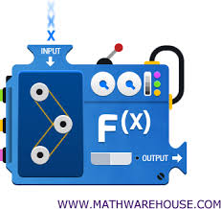
1-1 Relations and functions
LEARNING OBJECTIVE:
I CAN DETERMINE WHETHER A GIVEN RELATION IS A FUNCTION.
I can identify the domain and range of a relation or function.
I can evaluate functions
Essential question: What is the difference between a relation and a function?

Slide 2
Warm - up
Pair up with your elbow partner and answer each question based on what you remember from Algebra 3-4.
What are the three ways a relation or function may be represented?
How can it be determined if a relation is a function?
What are the domain and range of a relation or function?

Slide 3
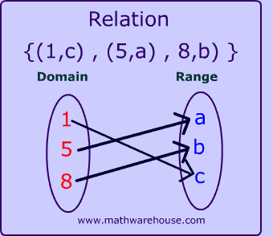
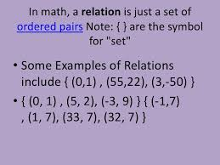
vOCABULARY
A Relation is a set of ordered pairs. The first elements in the ordered pairs (the input/x-values), form the domain. The second elements in the ordered pairs (the output/y-values), form the range. Each input value can have more than one output.
Word/Term
Category/ Definition
Example
Relation
- Set
Ordered Pairs
First Elements form Domain
Second Elements form Range
Each Input can have more than one output

Slide 4
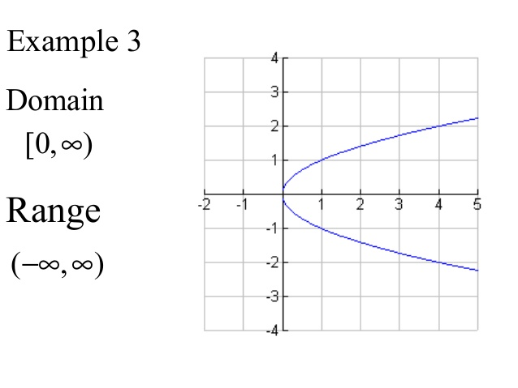
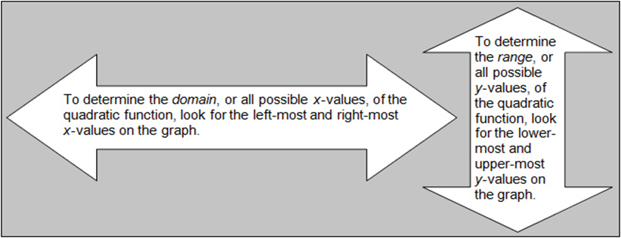
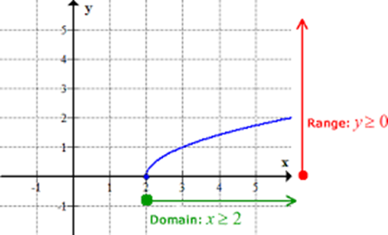
vOCABULARY
The Domain is the set of all possible x-values (input/Independent variable) which will make the function "work", and will output real y-values. Can be written using Brackets and Parenthesis ( ) or as inequalities.
Word/Term
Category/ Definition
Example
Domain
- Set
All possible
x - values
That will make the function “work”
Will output real y-values.
Written using Brackets and Parenthesis
Or as Inequalities

Slide 5
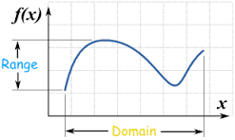
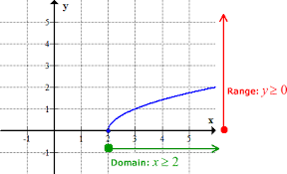
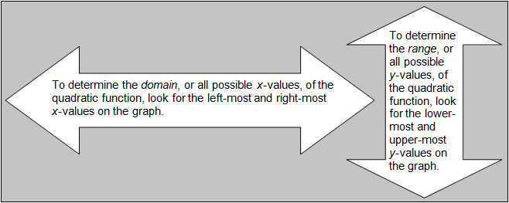
vOCABULARY
The Range is the set of all resulting y-values(Output/Dependent Variable) we get after substituting all the possible x-values. Can be written using Brackets and Parenthesis ( ) or as inequalities.
Word/Term
Category/ Definition
Example
Range
- Set
All possible
Resulting y - values
After substituting
All possible x-values.
Written using Brackets and Parenthesis
Or as Inequalities
ll

Slide 6
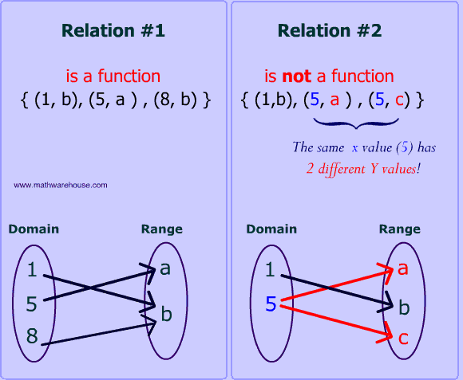
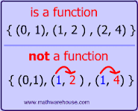
vOCABULARY
A Function is a relation in which each element of the domain(input/x-values) is paired with or has exactly one element in the range (output/ y-values). Function notation is written as "f(x)“ and is read as “ f of x” where x is the input value.
Word/Term
Category/ Definition
Example
Function
- Relation
Each domain(input) value
Results in EXACTLY ONE range (output)
value
Notation is f(x)
Read as “f of x”.
X is the input value
Can be written four different ways
- A set of ordered pairs
- A table of values
- A graph
- An equation

Slide 7
vOCABULARY
The Vertical Line Test is a test used to determine if a relation is a function. A relation is a function if there are no vertical lines that intersect the graph at more than one point.
Word/Term
Category/ Definition
Example
Vertical Line Test
- Test
Using a Vertical Line
To determine if the relation is a function.
Relation is a function if vertical line does not
intersect the graph more than once.

Slide 8
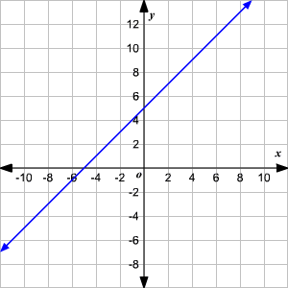
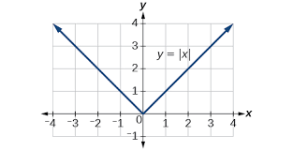
Warm-up
What is the difference between a relation and a function?
State the domain and range of each relation. Then state whether the relation is a function.
$\left\{\left(−3,0\right), \left(4,2\right), (2,−6)\right\}$
$\left\{\left(4,−2\right), \left(4,2\right), \left(9,−3\right), (−9,3)\right\}$
State the Domain and Range.
4. 5.

Slide 9
EX.1 – Writing a relation in different representations From a given domain and range.
State the relation as a table of values, as an equation, and graph the ordered pairs.
The domain is all integers greater than -5 and less than or equal to 4,
the range is 8 more than x, where x is a member of the domain.
Steps:
Determine the domain values
based on the given description.
Determine the range values
based on the given description.
Create a table of x & y values.
Graph the ordered pairs.
5. Determine the equation of the
relation.

Slide 10
EX.1 – Writing a relation in different representations from a given domain and range Cont’d.
State the relation as a table of values, as an equation,
and graph the ordered pairs.
b. The domain is all integers greater than or equal to -1 and less than 5,
the range is twice x, where x is a member of the domain.
.
Steps:
Determine the domain values
based on the given description.
Determine the range values
based on the given description.
Create a table of x & y values.
Graph the ordered pairs.
5. Determine the equation of the
relation.

Slide 11
EX.1 – Writing a relation in different representations from a given domain and range Cont’d.
State the relation as a table of values, as an equation, and graph the ordered pairs
The domain is all consecutive integers between -2 and 2.
The range is 2 less than twice x , where x is a member
of the domain.
.
Steps:
Determine the domain values
based on the given description.
Determine the range values
based on the given description.
Create a table of x & y values.
Graph the ordered pairs.
5. Determine the equation of the
relation using the range or by
looking at the graph.

Slide 12
Short summary #1
To ___________ a _________________ in different _____________
From a __________ domain and ____________, First I
write
relation

Slide 13
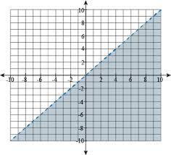
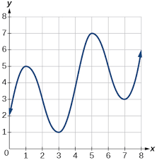
Ex.2 – Determining if a graph of a relation is a function
Determine if the graphs of the following relations represent a function. Explain.
STEPS:
1. Use the Vertical Line test.
a.)
b.)

Slide 14
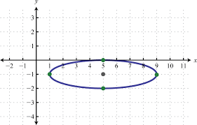
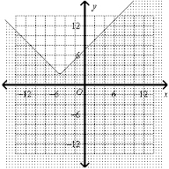
Ex.2 – Determining if a graph of a relation is a function cont’d
Determine if the graphs of the following relations represent a function. Explain.
STEPS:
1. Use the Vertical Line test.
c.)
d.)

Slide 15
SHORT SUMMARY #2

Slide 16
EX.3 – Finding the domain of a function
STEPS:
Determine if there are any
domain restrictions (Hint:
fractions or radicals)
If no domain restrictions,
the domain will be all real
numbers.
If there is a restriction because of a fraction, set the denominator equal to zero and solve. That answer will be the domain restriction.
If there is a restriction because of a radical, set the expression in the radicand
$≥0$and solve. That answer will be the domain.
2. State the domain
State the domain of the function.
a.) y = x – 5
$$b.) f\left(x\right)=\sqrt{x+1}$$
$$c.) g\left(x\right)=\frac{3−x}{5+x}$$
$$d.) f\left(x\right)=\sqrt{x^{2}−9}$$
$$e.) g\left(x\right)=\frac{3}{x−1}$$
$$f.) f\left(x\right)=\frac{x+3}{\sqrt{x^{2}−6}}$$

Slide 17
Short summary #3

Slide 18
EX.4 – Evaluating Functions
Evaluate each function for the given value.
$$\text{a}\text{.) }\text{f}\text{(3) }\text{if} \text{f}\text{(}\text{x}\text{) = 2}\text{x}\text{ + 3}$$
b.) h(-4) if h(x) = x² + 6x - 5
Steps:
Substitute given value into
the expression for the
appropriate variable.
2. Simplify the expression.
c.) g(n - 1) if g(x) = 2x² – x + 9
d.) f(2a) if f(x) = 4x² + 7

Slide 19
Short summary #4
Homework Assignment# 6:
Sec.1-1 Text pp. 10-12
Problem #s 18-56even and 57.
Short Summaries 1-4 and Complete Summary
8 Questions

